Slide 1
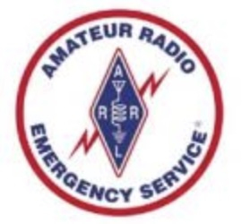

SC ARES / SC AuxComm
September 2025 – Statewide CommEx Results
Information contributed, compiled, and reported by:
Dennison Coomer (SCEMD ESF2)
Matt Catoe (SCEMD)
Roger Mull (KD4JQJ)
Robert Webster (WR8RW)
28 October 2025

Slide 2
Exercise Objectives:
- Using readily available equipment attempt to complete point-to-point voice contacts using the 40-meter, 2 -meter, and 6-meter bands
-Using readily available equipment attempt to complete digital (WinLink) contacts between “field” stations and SC EMD addresses NCS800 and NCS802
-Collect registrant and participant data for subsequent evaluation of equipment and communications protocols effectiveness
-Present the collected and analyzed information / data to all participants for the purposes of:
*Ultimately understanding the best equipment “profiles” to use in operational situations
*Understanding any identified short comings / gaps that will generate improvement efforts
*Developing courses or programs of training that will improve message traffic passing
2

Slide 3
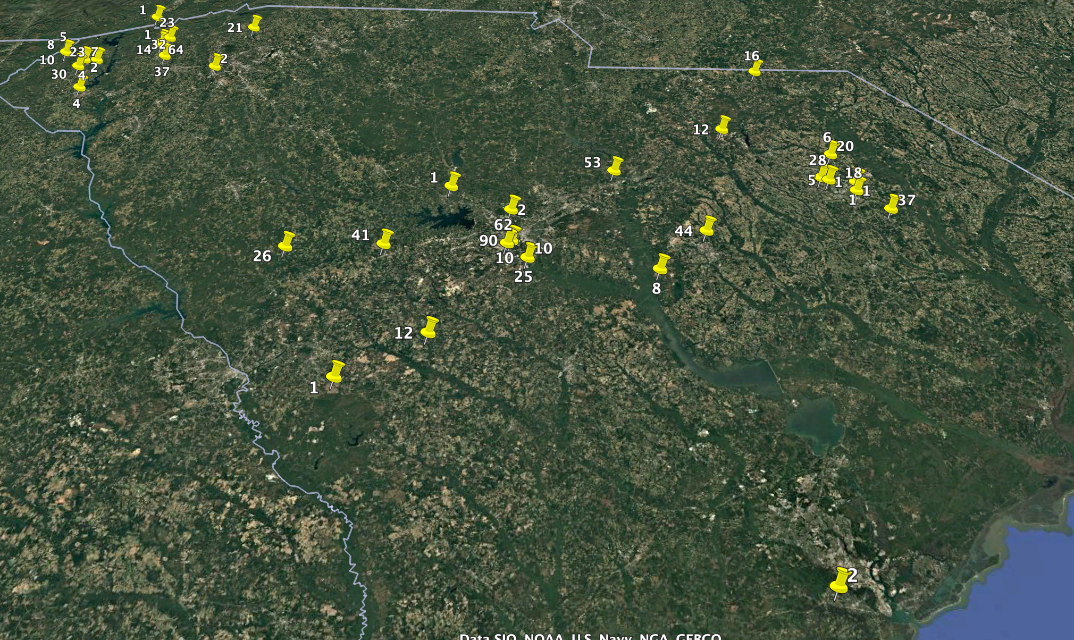
Stations Making 40 M Contacts & The Number Of Contacts Made By Those Stations
3

Slide 4
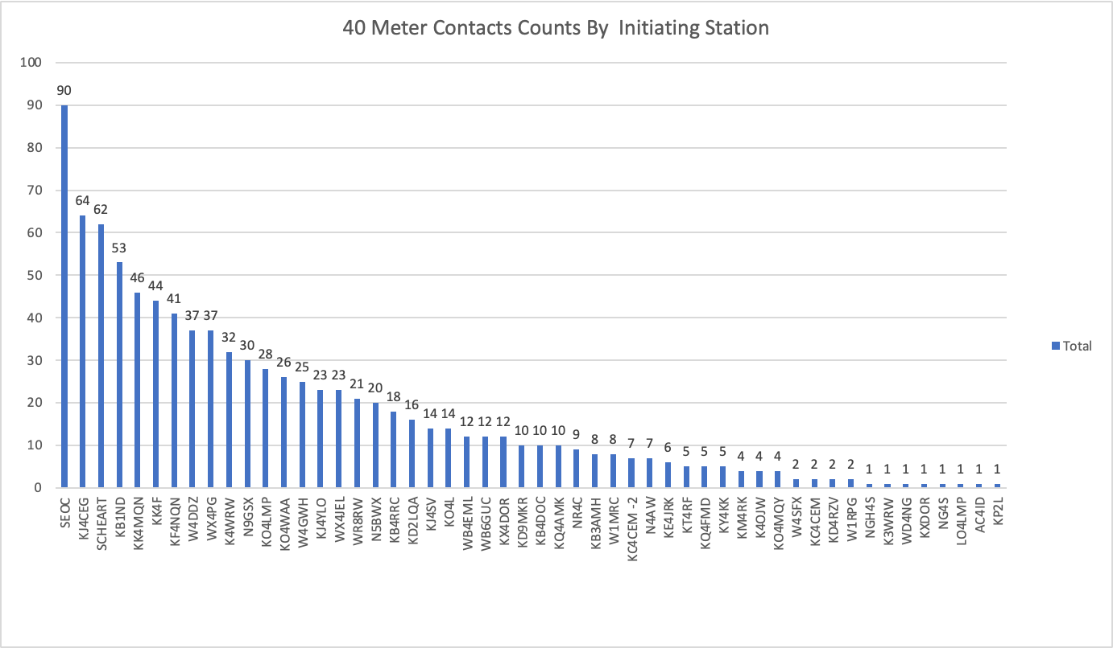
4

Slide 5
5
Notes:
839 of the contacts were received at S5 or better 91% of all HF contacts were received at S5 or better

Slide 6
6
Notes:
Percentage of stations reporting contact = 32% of 171 registrants. 68% of registrants didn’t report a contact

Slide 7
7
Notes:
37% of all logged HF contacts were listen only. 63% of all logged HF contacts were two-way.

Slide 8
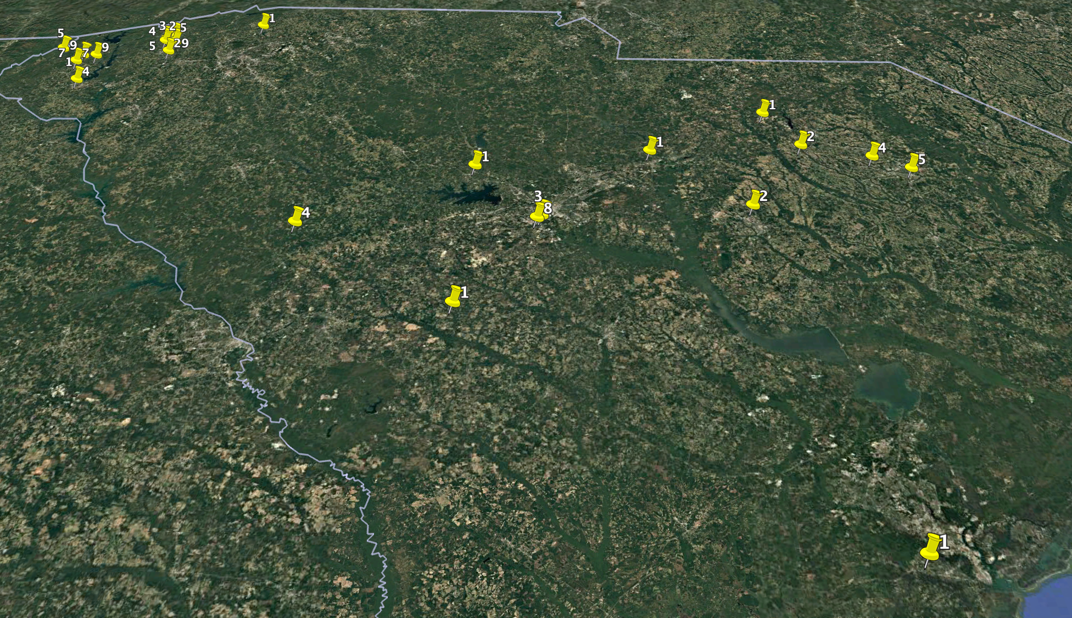
Stations Making 2M Contacts & The Number Of Contacts Made By Those Stations
8

Slide 9
9

Slide 10
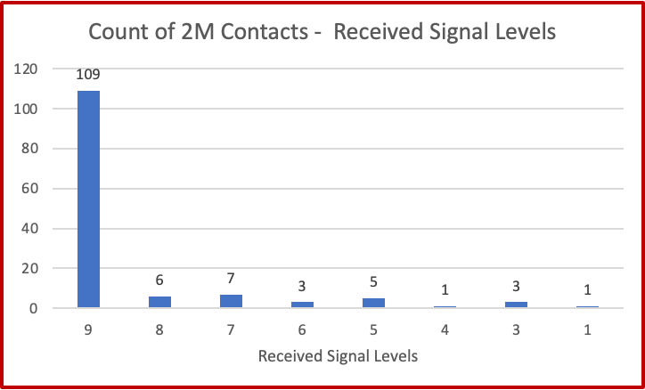
10
Notes:
85% of 2M Contacts were documented at S9

Slide 11
11
Notes:
22% of registered stations reported contacts 78% of the registered contacts did not report any contacts

Slide 12
12
Notes:
87.7% were two-way 12.3% were listen only

Slide 13
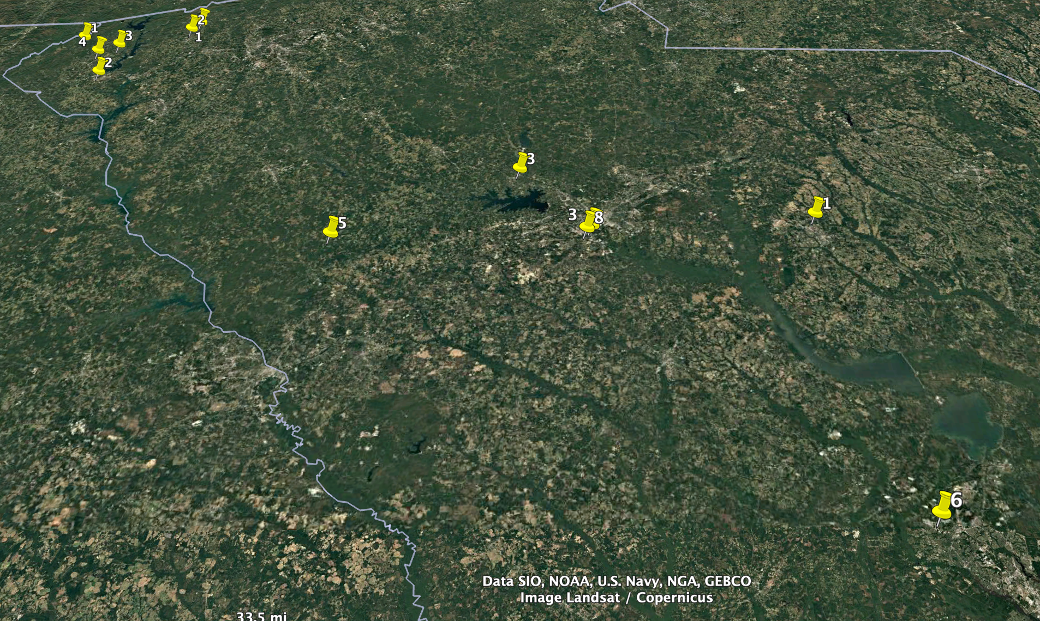
Stations Making 6M Contacts & The Number Of Contacts Made By Those Stations
13

Slide 14
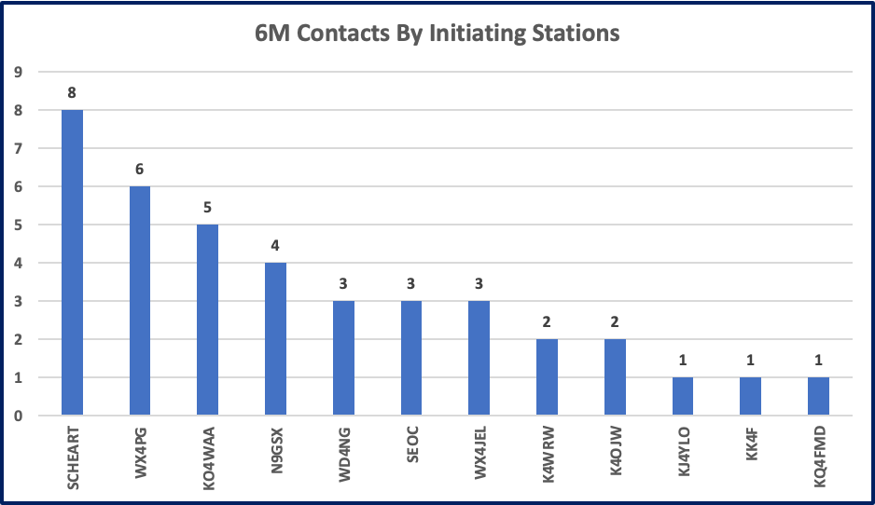
14

Slide 15
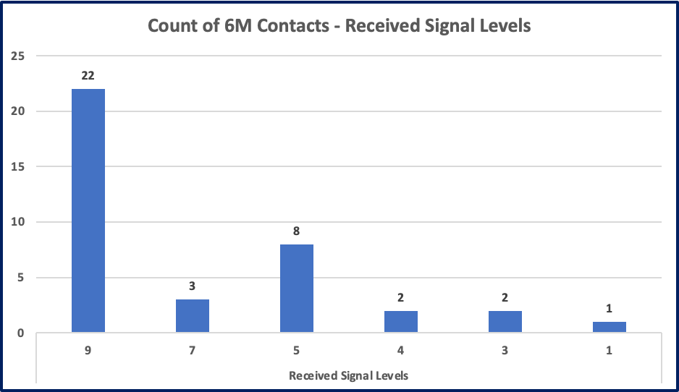
15
Notes:
87% of signals were received at S5 or better

Slide 16
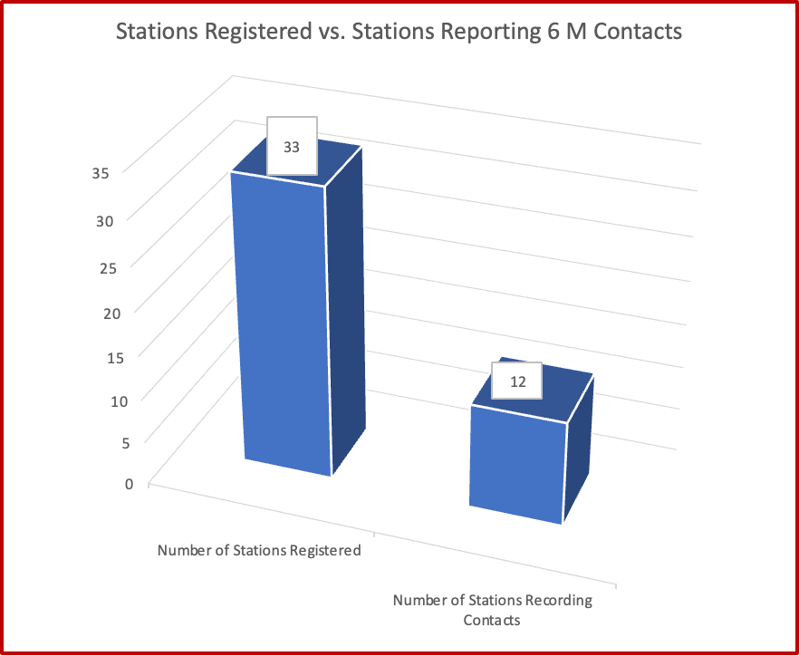
16
Notes:
26% of registered stations reported contacts

Slide 17
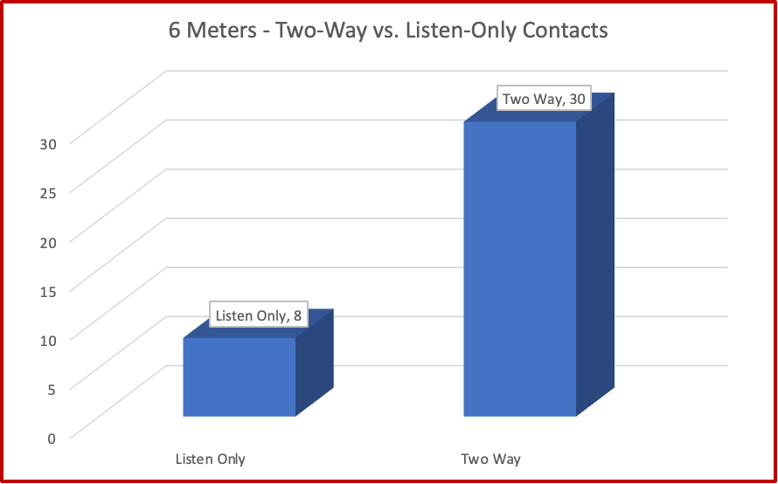
17
Notes:
77% of registered stations completed two-way contacts

