Slide 1

3rd Tuesday of the month Skywarn Zoom Call
April 21, 2026
Mark, KN4KRZ
NWS Columbia, Midlands Area, Acting Coordinator

Slide 2
Agenda
First up – Our special guest presenter
Melissa Griffin
DNR, Assistant State Climatologist
Other Skywarn Midlands Business
Closing

Slide 3

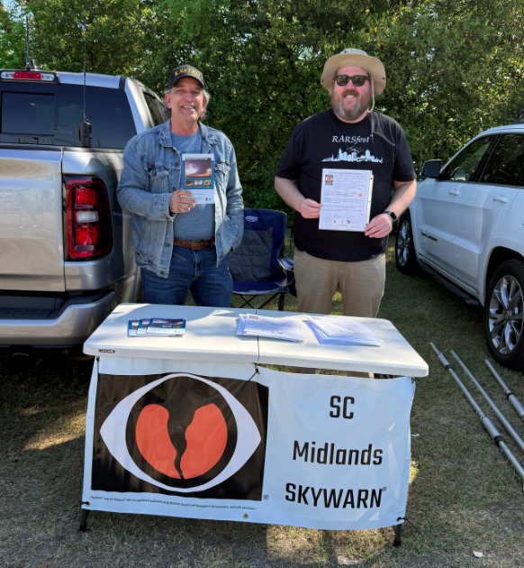
Link to the flyer:
South Carolina Midlands Skywarn Flyer Rev. 4.6.26
Manning the SC Midlands Skywarn booth during the
Ridge Amateur Radio Club Tailgate are (Left) Michael Connelly, KX4TKO, and (Right) Matthew Crook, W1MRC.

Slide 4
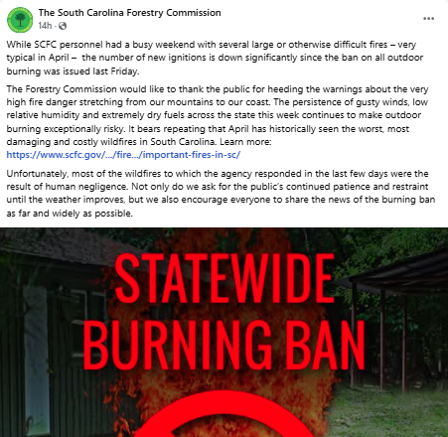

Slide 5
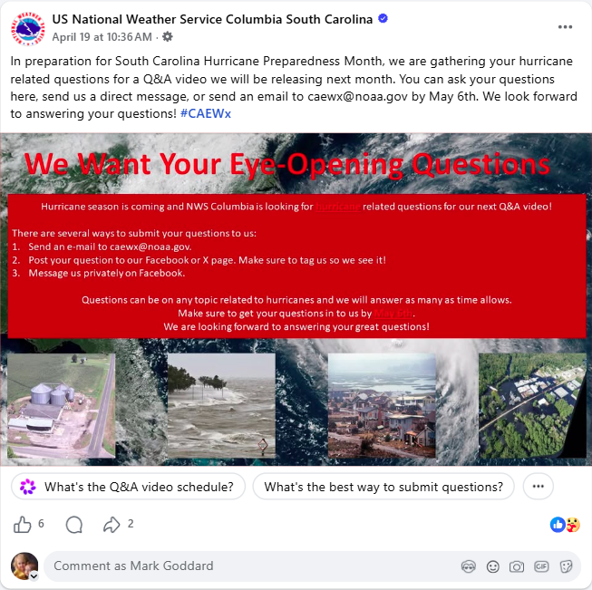

Slide 6
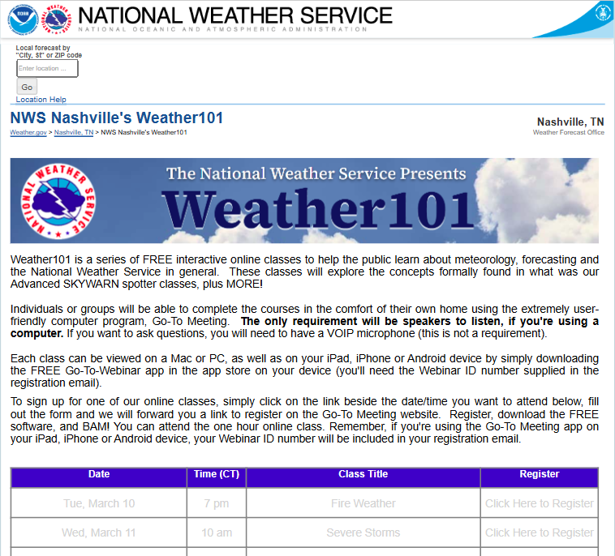
Skywarn Training opportunities
Weather 101 – Virtual 1-hour sessions,
Underway during March, April, and May
Registration in advance is required.
https://www.weather.gov/ohx/weather101

Slide 7
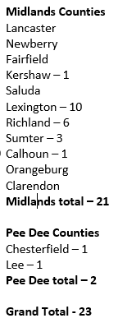
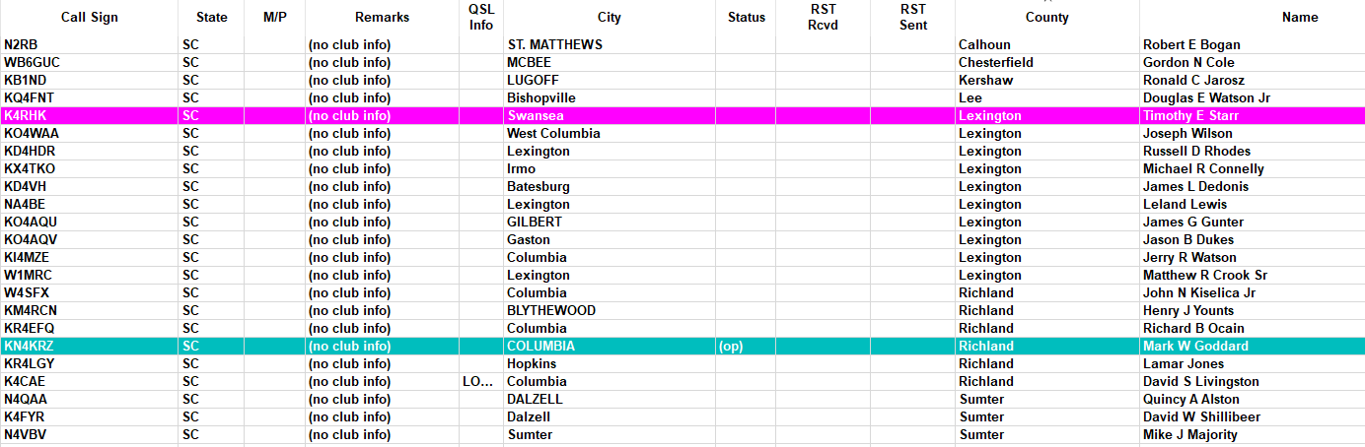
This month – April 14th NWS Cola Midlands Skywarn FT Net

Slide 8
Opportunities/Recap
Training
Weather 101 – March, April & May
Other training, as available
Spotter engagement
Continue to explore outreach opportunities with Amateur radio clubs, ARES groups, County Ems/EOCs
PACE
Primary – Zello – We practice Zello regularly, during monitoring/activations and on the 3rd Tuesdays of the month.
Alternate – FleetTalk – We practice FleetTalk regularly, during monitoring/activations and on the 2nd Tuesdays of the month.
Contingency – Skywarn designated repeaters – May 12th explore a plan to test repeaters after the FleetTalk net.
Emergency – Suggestions for HF practice
SC Statewide ARES HF Net – Tuesdays, 6:00 PM on frequency 3.990 (+/-) LSB
SC SSB (NTS) – Daily, 7:00 PM on frequency 3.915 LSB
NWS Columbia – Continue efforts to restore radio capabilities. Tentative revisit date Thursday, May 14th.
Notes:
.

